Slide 1
Making this resource work for you
Prior to teaching this lesson, please refer to the ‘Unit Overview and Planning Document’.
Further guidance on planning Science Mastery lessons can be found in the detailed planning guidance document.
Refer to the ‘notes’ section on each slide for useful information, including suggested expositions, pedagogical content knowledge, suggested questions, answers and more. Consider using presenter mode so you can see this guidance throughout the lesson.
The introduction slides can be adapted to suit your teaching style and the needs of your class.
Before the lesson, adapt the fix-it slide to address any misconceptions identified in the previous lesson’s exit ticket.
Choose from the suggested activities to suit your class. The intention is not that you complete all of these, but that you select those which ones are most appropriate for your students. It may be appropriate to further adapt activities for your students.
These lessons are designed to occupy approximately 1 hour. To adapt for a shorter or longer lesson duration we advise you to adapt the activity section accordingly.
Please consider using the final slide to send feedback about this lesson or examples of PowerPoints that you have adapted to our design team. Your feedback is used to improve Science Mastery for all of our teachers and students. We appreciate all suggestions and comments.
Thank you for reading!
The Science Mastery Team

Slide 2

Obtaining Raw Materials
Answer the questions below.
Define ‘potable’ water.
Soda-lime glass is made by heating a mixture of which 3 substances?
A copper ore with a mass of 70 g contains 20% copper. What is the mass of copper in the ore?
What is meant by ‘sustainable development’?
State one non-renewable source of energy.
Water that is safe/clean enough to drink.
sand, sodium carbonate and limestone
14 g
Sustainable development is development that meets the needs of current generations without compromising the ability of future generations to meet their own needs.
Coal, oil or natural gas
Notes:
Big idea: Reactions Rearrange Matter
Foundation: Write a word equation for the reaction of copper with oxygen to form copper oxide.
Stretch: Write a balanced chemical equation for the reaction of copper with oxygen to form copper oxide.
Answers:
Foundation: copper + oxygen → copper oxide
Stretch: 2Cu + O₂ → 2CuO

Slide 3
Obtaining Raw Materials
Do Now:
Define ‘potable’ water.
Soda-lime glass is made by heating a mixture of which 3 substances?
A copper ore with a mass of 70 g contains 20% copper. What is the mass of copper in the ore?
What is meant by ‘sustainable development’
State one non-renewable source of energy.
Drill:
Write a word equation for the reaction of copper with oxygen to form copper oxide.
Write a balanced chemical equation for the reaction of copper with oxygen to form copper oxide.
Notes:
Answers:
Do Now:
Water that is safe/clean enough to drink.
sand, sodium carbonate and limestone
14 g
Sustainable development is development that meets the needs of current generations without compromising the ability of future generations to meet their own needs.
Coal, oil or natural gas
Drill:
1. copper + oxygen → copper oxide
2. 2Cu + O₂ → 2CuO

Slide 4
Obtaining Raw Materials
Read Now:
Small sea creatures called bloodworms can burrow several metres down through the ocean floor. Scientists have learned that this is partly due to their remarkable jaws, which are made from a high proportion of copper! The jaws act like a composite material, like fibreglass or rubber filled reinforced tyres. A single protein is responsible for forming this jaw material, using copper from the environment. Researchers hope that by studying this material, they can improve other composite materials like concrete.
Why can bloodworms burrow several metres down through the seabed?
What metal is contained in the jaws of a bloodworm?
State an example of a composite material.
What do researchers hope to gain by studying the jaws of a bloodworm?
Define the word in bold.
Notes:
Answers:
They have strong jaws made from a high proportion of copper
copper
fibreglass, reinforced concrete
Researchers hope to improve other composite materials such as concrete
Burrow – to dig down (for example into soil)

Slide 5

C4.2.14
31/01/2025
(HT) Obtaining Raw Materials
C4.2.1 PKR: Reactions of Metals
C4.2.2 Extracting Less Reactive Metals
C4.2.3 PKR: Ions, Ionic Bonding and Deducing Ionic Formulae
C4.2.4 (HT) Ionic Equations and Displacement Reactions
C4.2.5 (HT) Writing Half Equations
C4.2.6 (HT) Ionic Equations for the Reactions of Acids and Metals
C4.2.7 Introduction to Electrolysis
C4.2.8 Extracting Metals by Electrolysis
C4.2.9 Electrolysis of Molten Ionic Compounds
C4.2.10 Electrolysis in Solutions
C4.2.11 RP: Electrolysis of Aqueous Solutions
C4.1.12 RP: Electrolysis of Aqueous Solutions
C4.1.13 TIF: Corrosion and its Prevention
C4.2.14 (HT) Obtaining Raw Materials
C4.2.15 Recycling Metals
C4.2.16 Feedback Lesson
Notes:
Big Idea: Reactions Rearrange Matter
Suggested Hook: See slide 8

Slide 6

Following this lesson, students will be able to:
List some disadvantages of mining and quarrying
Define bioleaching and phytomining
Explain how bioleaching and phytomining are carried out
Key Words:
bioleaching
leachate
phytomining
low-grade ore
Notes:
Guidance:
See unit overview document and planning guidance to see how these objectives are typically assessed at GCSE, including examples of what students should be able to do following this lesson.
Planning for different needs:
The learning objectives given on this slide are suggested based on the most common requirements for exams, however they can be adapted based on the needs of different classes.
For best practice, the unit preparation booklet should be used to determine the appropriate focus of lessons within the unit.
While it is not possible to explicitly split content into levelled grades, we recommend that lesson objectives can be classified as critical, core or stretch.
Critical: the content or skill is essential for all students to be able to progress.
Core: the content or skill is important for students to progress, but other opportunities may be available to revisit it.
Stretch: the content or skill may not be essential for all students but is important for students aiming for the highest grades.
Key skill: this is a crucial skill being developed in this unit as part of the skill mapping
C4.2.14 Lesson Objectives:
Core: List some disadvantages of mining and quarrying
Critical: Define bioleaching and phytomining
Critical: Explain how bioleaching and phytomining are carried out

Slide 7
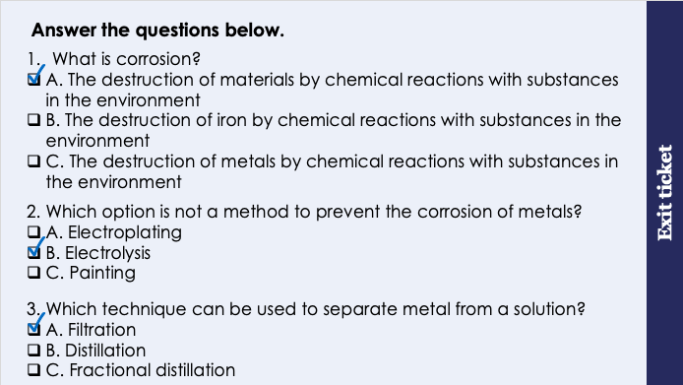
This is the fix-it portion of the lesson
The fix-it is an opportunity to respond to gaps in knowledge, especially those identified by the previous lesson’s exit ticket.
The teacher should customise this slide as needed, to facilitate
reteach, explanation, demonstration or modelling of ideas and concepts that students have not yet grasped or have misunderstood.
practise answering specific questions or of key skills.
redrafting or improving previous work.
Notes:
Purpose: to spend time on any gaps identified in previous learning from exit ticket feedback.
Fix-it guidance from previous exit ticket:
Q1. Answer: A
If students answer B or C, they cannot recall the exact definition for corrosion, and may be confusing this with rusting. To fix-it, show students various examples of corrosion and ask them to recite this definition.
Q2. Answer: B
If students answer A or C, they cannot recall the methods used to prevent corrosion, and may be confusing electroplating with electrolysis. To fix-it, ask students to explain how each method prevents corrosion by forming a barrier between the material and the environment.
Q3. Answer: A
If students answer B or C, they cannot recall how a solid metal can be separated from the liquid solution. To fix-it, ask students to summarise each of these separation techniques with a labelled diagram, and to give an example of a solution that can be separated with each.

Slide 8

Extracting Copper
Copper prices have increased rapidly since 2003.
Why might this be?
Copper-rich ores are becoming more scarce.
Notes:
Exposition type: Explanation
Model teacher exposition:
Copper prices have increased rapidly since 2003. Why do you think this is? Copper-rich ores are becoming more scarce.
We have mined copper ores for many years to extract the copper from them. Copper ores are non-renewable.
We use a huge amount of copper worldwide , mostly for electrical equipment such as wiring and motors.

Slide 9
Extracting Copper
Copper ores vary in the percentage of copper they contain.
If they contain very little copper, extracting it might be more costly than it is worth!
As the availability of high-grade copper ores dwindles, scientists are looking for more effective ways to use low-grade copper ores to obtain copper.
There are two main methods currently being used:
Bioleaching
Phytomining
Notes:
Model teacher exposition:
Some copper ores contain a high percentage of copper, and some some copper ores contain less copper.
In 1950, the ores we used to get copper had 90% copper! By 2010, we were using ores that contain just 30% copper.
If ores contain a small percentage of copper it can be extremely expensive to extract (and sometimes not worth it). We call copper ores with a low percentage of copper ‘low-grade copper ores’.
Because high-grade copper ores are becoming more scarce, scientists have had to find some effective ways to extract copper from low grade ores. The two methods we will learn about today are bioleaching and phytomining.
Using these methods means that we don’t need to mine for ores or to create large quarries. Obtaining raw materials from the Earth by quarrying and mining causes environmental impacts, such as contamination of nearby water sources, noise pollution, habitat loss, deforestation, and the quarries look unattractive.

Slide 10
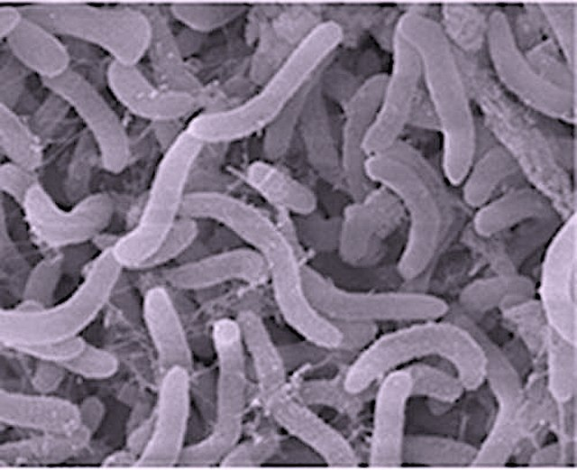
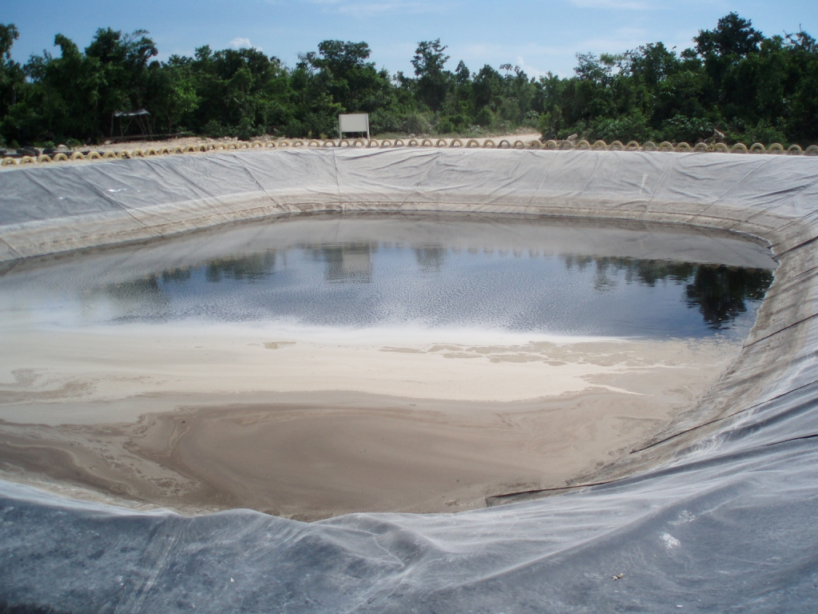
Bioleaching
This method produces around 20-25% of all copper extracted from ores.
However, there is a long way to go with bioleaching… Scientists are looking for ways to speed up this process which can take years!
Bioleaching is a method to extract metals from their ore using living organisms such as bacteria.
Bacteria are added to low-grade ores.
2. They ‘feed’ on the ore, creating a solution of ions called leachate.
3. The copper solutions are then purified using displacement reactions or electrolysis.
Notes:
A video can be used to support students’ understanding of bioleaching e.g. https://www.youtube.com/watch?v=aSb5PNwrRx0
Model teacher exposition:
Bioleaching is a method to extract metals from their ore using living organisms such as bacteria.
What about the word ‘bioleaching’ gives us a clue as to its meaning? ‘Bio’ means living thing
For bioleaching to occur
First, bacteria are added to low-grade ores
Then, these bacteria feed on that ore and create a solution of ions called a leachate. The image here shows a large pool of leachate.
Finally, this solution containing copper ions is processed to extract the copper. This can be done by a displacement reaction or by electrolysis. For example, copper can be obtained from solutions of copper compounds by displacement using scrap iron or by electrolysis.
This method currently produces 20-25% of all copper tht e currently extract from ores. However, scientists have a long way to go to make this a fast process. Currently, it can take years!

Slide 11




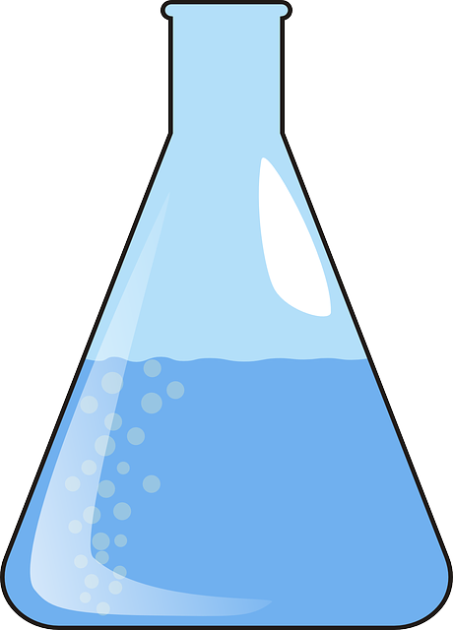
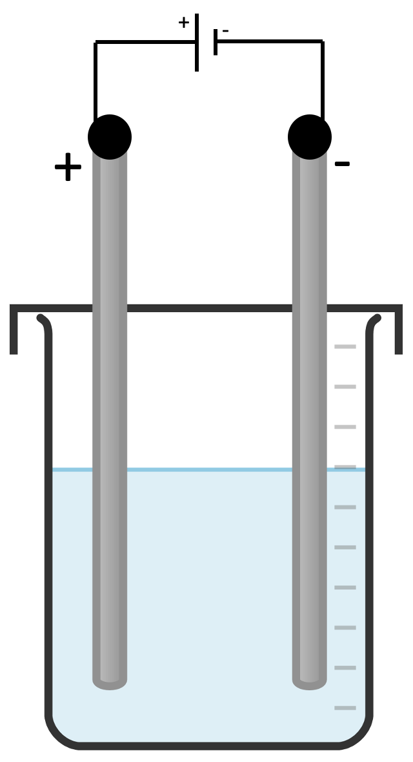
Phytomining
Phytomining is a method to extract copper metal from low-grade copper ore in soil, using plants
1.
2.
3.
4.
5.
Did you know?
The prefix ‘phyto-’ means ‘derived from plants’
Notes:
These diagrams are provided on a separate document that can be printed to support students to make notes on the steps of phytomining.
Model teacher exposition:
The second method of extracting metal from a low-grade ore is phytomining. Phytomining is used to extract copper metal from the low grade ore in soil, using plants.
Hand out the phytomining storyboard.
I am going to go through each step, to tell you about phytomining. I would like you to listen carefully, and annotate (write) into the storyboard sheet to record the most important information for each stage. You may use labels, written text, or drawings to add this information to your storyboard.
Step 1: Soil contains low grade copper ore. Plants absorb the metal ions from the soil, using their roots, and store them.
Step 2: The plants are burned in oxygen. This produces waste carbon dioxide gas (CO₂).
Step 3:The oxygen gas reacts with the copper ions in the plant, to make copper oxide (CuO). This looks like black ash. Copper oxide is an ore of copper.
Step 4: This copper oxide is added to sulphuric acid to form copper sulphate solution (a blue liquid). CuO + H₂SO₄ → CuSO₄ + H₂O
Step 5: Electrolysis is used to extract pure copper from the copper sulphate solution. The copper ions are discharged at the cathode (negative electrode).

Slide 12

Is this statement correct?
Bioleaching is a method to extract copper metal from low-grade copper ore in soil, using plants
Notes:
Answer: it is incorrect because bioleaching uses bacteria and not plants.

Slide 13
Drill
State a use of copper metal.
Are copper ores renewable or non-renewable?
What word is given to a copper ore containing a low percentage of copper?
State one disadvantage of mining copper ores.
List two methods that can be used to effectively extract copper from low-grade copper ores.
Define bioleaching.
Define phytomining.
When bacteria feed on are ore, what do we call the solution of metal ions that they produce?
What process is used to extract pure copper metal from a copper sulphate solution?
At which electrode will copper metal form in electrolysis?
Notes:
Purpose: This is a knowledge drill. The purpose of this is to check that the critical knowledge is secure before pupils move onto independent practice.
Suggested guidance: There are a range of ways this could be done depending on time and ability range of the class:
Mini whiteboards
As full sentences in exercise books
As short answers in exercise books
In the pupil workbook
As pair talk
As cold call

Slide 14
Drill answers
Copper metal is used for electrical wiring.
Copper ores are non-renewable.
Low-grade copper ores contain a low percentage of copper
One disadvantage of mining copper ores is that it can result in habitat destruction.
Phytomining and bioleaching can extract copper from low-grade ores.
Bioleaching is a method to extract metals from their ore using living organisms such as bacteria.
Phytomining is a method to extract copper metal from low-grade copper ore in soil, using plants
When bacteria feed on an ore, they produce a leachate
Electrolysis is used to extract copper from a copper sulphate solution
Copper metal will form at the cathode (negative electrode)
Notes:
Purpose: This is a knowledge drill. The purpose of this is to check that the critical knowledge is secure before pupils move onto independent practice.
Suggested guidance: There are a range of ways this could be done depending on time and ability range of the class:
Mini whiteboards
As full sentences in exercise books
As short answers in exercise books
In the pupil workbook
As pair talk
As cold call

Slide 15

I: Describe: to recall facts, events or processes in an accurate way
Example question:
To ‘describe’, your answer should:
Use bullet points to keep your answer clear
Cover enough points to fully answer the question
Use scientific keywords in your answer
‘Say what you see’ if there is a diagram, graph or table.
Phytomining is used to obtain copper from land that contains very low percentages of copper compounds.
Describe how copper compounds are obtained by phytomining.
Model answer:
grow plants on land containing copper ores
burn the plants to form ash (copper oxide)
dissolve the copper oxide in (sulfuric) acid to form copper sulfate (leachate) solution
carry out the electrolysis of this solution to form pure copper
Notes:
This slide models the process of answering a describe question.
Firstly, students are presented with a generic describe question, along with a model answer. Students are also given some simple guidance to follow for producing their own describe answer.
The generic question and answer should be used by the teacher to remind students of
the key features of a great answer
how to structure their answer
why the model answer is a good example
Following this, students will be required to apply this process to answer their own describe question, which will appear in place of the generic questions. This describe question will be specific to the topic students are learning about in the lesson. Give students time to write their own answer to this, ensuring that they use the guidance provided. To further scaffold this task for students, it may be appropriate to:
pair students up to write an answer together
list for students the key words you would like them to include in the answer
provide a writing frame or ‘points to include’ for students
A model answer for this question will appear. Teachers should review the model answer with students by referencing the guidance in the green box. For example ‘we can see item 1 in the guidance is to use bullet points to keep your answer clear. Notice in the model answer here we have done just that’. Or ‘item 2 in the guidance here says that we should use scientific keywords in the answer. Has this been achieved in the model answer? Where can we see this?’.

Slide 16
We: Describe: to recall facts, events or processes in an accurate way
Example question:
To ‘describe’, your answer should:
Use bullet points to keep your answer clear
Cover enough points to fully answer the question
Use scientific keywords in your answer
‘Say what you see’ if there is a diagram, graph or table.
Soil near copper mines is often contaminated with low percentages of copper compounds.
Phytomining is a new way to extract copper compounds from soil.
Describe how copper compounds are extracted by phytomining.
Model answer:
grow plants on land containing copper ores
burn the plants to form ash (copper oxide)
dissolve the copper oxide in (sulfuric) acid to form copper sulfate (leachate) solution
carry out the electrolysis of this solution to form pure copper
Notes:
This slide models the process of answering a describe question.
Firstly, students are presented with a generic describe question, along with a model answer. Students are also given some simple guidance to follow for producing their own describe answer.
The generic question and answer should be used by the teacher to remind students of
the key features of a great answer
how to structure their answer
why the model answer is a good example
Following this, students will be required to apply this process to answer their own describe question, which will appear in place of the generic questions. This describe question will be specific to the topic students are learning about in the lesson. Give students time to write their own answer to this, ensuring that they use the guidance provided. To further scaffold this task for students, it may be appropriate to:
pair students up to write an answer together
list for students the key words you would like them to include in the answer
provide a writing frame or ‘points to include’ for students
A model answer for this question will appear. Teachers should review the model answer with students by referencing the guidance in the green box. For example ‘we can see item 1 in the guidance is to use bullet points to keep your answer clear. Notice in the model answer here we have done just that’. Or ‘item 2 in the guidance here says that we should use scientific keywords in the answer. Has this been achieved in the model answer? Where can we see this?’.

Slide 17
You: Describe: to recall facts, events or processes in an accurate way
Example question:
To ‘describe’, your answer should:
Use bullet points to keep your answer clear
Cover enough points to fully answer the question
Use scientific keywords in your answer
‘Say what you see’ if there is a diagram, graph or table.
Phytomining is used to obtain copper from land that contains very low percentages of copper compounds.
Describe how copper compounds are extracted by phytomining.
Model answer:
grow plants on land containing copper ores
burn the plants to form ash (copper oxide)
dissolve the copper oxide in (sulfuric) acid to form copper sulfate (leachate) solution
carry out the electrolysis of this solution to form pure copper
Notes:
This slide models the process of answering a describe question.
Firstly, students are presented with a generic describe question, along with a model answer. Students are also given some simple guidance to follow for producing their own describe answer.
The generic question and answer should be used by the teacher to remind students of
the key features of a great answer
how to structure their answer
why the model answer is a good example
Following this, students will be required to apply this process to answer their own describe question, which will appear in place of the generic questions. This describe question will be specific to the topic students are learning about in the lesson. Give students time to write their own answer to this, ensuring that they use the guidance provided. To further scaffold this task for students, it may be appropriate to:
pair students up to write an answer together
list for students the key words you would like them to include in the answer
provide a writing frame or ‘points to include’ for students
A model answer for this question will appear. Teachers should review the model answer with students by referencing the guidance in the green box. For example ‘we can see item 1 in the guidance is to use bullet points to keep your answer clear. Notice in the model answer here we have done just that’. Or ‘item 2 in the guidance here says that we should use scientific keywords in the answer. Has this been achieved in the model answer? Where can we see this?’.

Slide 18
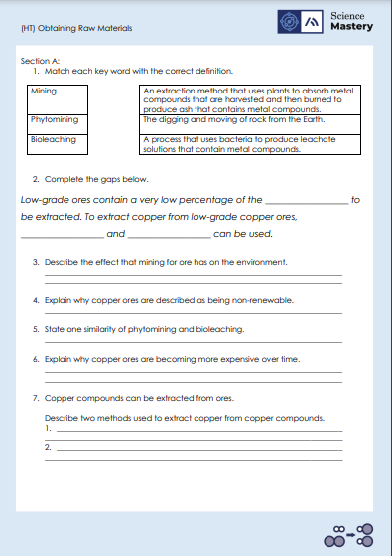
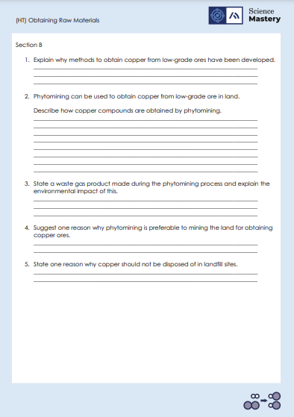
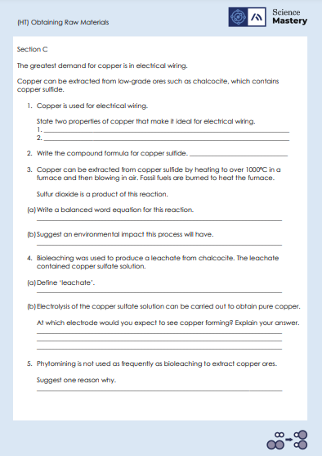
Activity

Slide 19
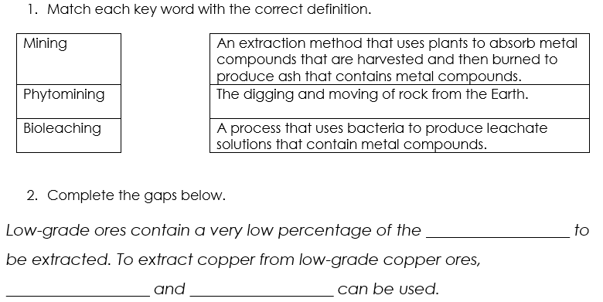
Answers – Section A
metal
phytomining
bioleaching

Slide 20
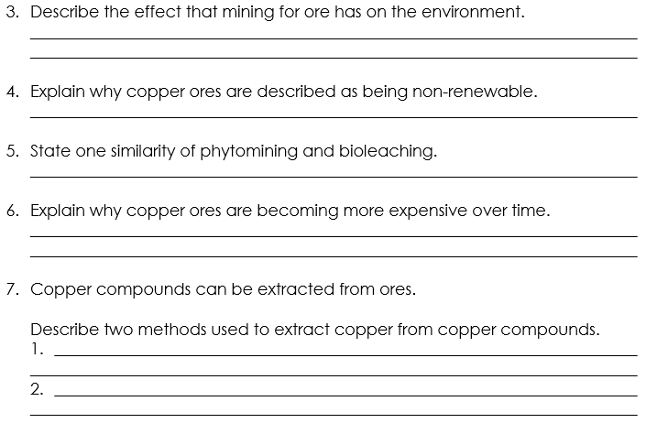
Answers – Section A
Destroys habitats
Fixed amount on Earth and doesn’t replenish
Both use organisms. Both used to obtain copper ore from low-grade ore
Copper ore is becoming more scarce.
Methods used to extract copper ore are costly.
Reduction with carbon.
Electrolysis of copper compounds in solution.

Slide 21
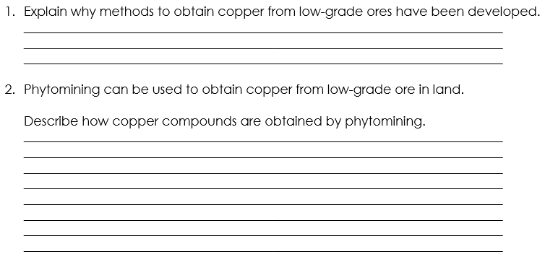
Answers – Section B
Copper is a non-renewable resources and is becoming more scarce. We need copper to make electrical wiring so methods have been developed for extraction from the remaining low-grade ores.
Plants absorb metal ions from soil containing low-grade copper ore and store them.
The plants are burned in oxygen to produce copper oxide and carbon dioxide.
The copper oxide is added to sulfuric acid to form copper sulfate solution which is then electrolysed to obtain pure copper.
Notes:
Step 1: Soil contains low grade copper ore. Plants absorb the metal ions from the soil, using their roots, and store them.
Step 2: The plants are burned in oxygen. This produces waste carbon dioxide gas (CO₂).
Step 3:The oxygen gas reacts with the copper ions in the plant, to make copper oxide (CuO). This looks like black ash. Copper oxide is an ore of copper.
Step 4: This copper oxide is added to sulphuric acid to form copper sulphate solution (a blue liquid). CuO + H₂SO₄ → CuSO₄ + H₂O
Step 5: Electrolysis is used to extract pure copper from the copper sulphate solution. The copper ions are discharged at the cathode (negative electrode).

Slide 22
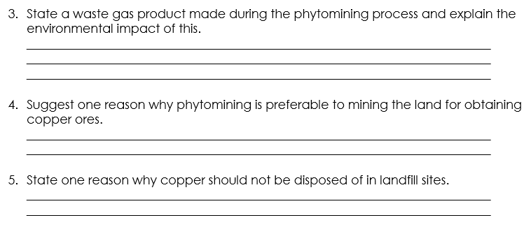
Answers – Section B
Carbon dioxide is the waste gas produced which has an environmental impact because carbon dioxide is a greenhouse gas contributing to global warming.
Reduces the need for mining of rock which destroys habitats.
Copper ore is running out so should be recycled/reused.
Landfill sites are filling up.
Copper compounds are toxic to organisms

Slide 23
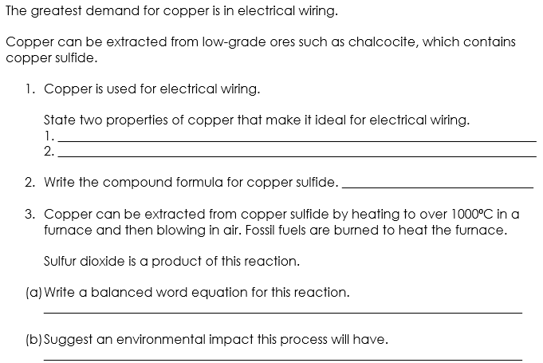
Answers – Section C
Good electrical conductor
Ductile
CuS
CuS + O₂ → Cu + SO₂
SO₂ pollutes the atmosphere.
Using fossil fuels produces CO₂ which is a greenhouse gas.

Slide 24
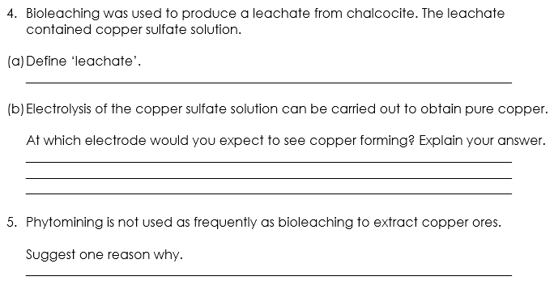
Answers – Section C
A solution of ions produced by bacteria in bioleaching.
At the negative electrode (cathode) because copper ions are positively charged so move towards the negative electrode.
Land may not be available.
Takes a long time for plants to grow.

Slide 25
Answer the questions below.
State the name of the process where plants are used to extract metals from compounds.
A. Phytomining
B. Bioleaching
C. Mining
✓
2. Copper is now extracted from ores containing a low percentage of copper compounds. Why is this?
A. Other methods are too expensive
B. Copper ores are becoming scarce
C. So that electrolysis can be carried out
✓
3. Why is phytomining preferable to traditional mining of copper ores?
A. It results in less destruction of habitats
B. It is faster
C. It is more expensive
✓
Notes:
Q1. Answer: A
If students answer B or C, they are unable to define the methods of extracting metals from ores. To fix-it, ask students to review their notes and then to define each term.
Q2. Answer: B
If students answer A or C, they do not understand why alternative methods of extraction are needed. To fix-it, show students the graphs on slides 8 and 9 of this powerpoint and ask them to explain what they tell us.
Q3. Answer: A
If students answer B or C, they are unable to describe a disadvantage of traditional mining. To fix-it, ask students to create a table that compares traditional mining with phytomining, including any environmental effects.

Slide 26
Lesson C4.2.14
What was good about this lesson? | What can we do to improve this lesson?
Send us your feedback by clicking this link
or by emailing sciencemastery@arkonline.org
Thank you!

